Slide 1


Major Project
AdaptiPlan: Intelligent Scenario Modelling for
Climate Change Mitigation
Presented by:
R2142210244- Charu Gupta
R2142210448- Lakshay Agarwal
Mentored By:
Dr. Tanupriya Choudhury

Slide 2
Content
Introduction
Literature Review
Objectives
Methodology
References

Slide 3
Introduction
Technical Concepts (Algorithms):
The technical concepts used are:
LSTM (Long Short-Term Memory): A type of recurrent neural network (RNN) specialized for time series forecasting. LSTMs excel at capturing long-term dependencies and nonlinear relationships in sequential data, making them ideal for climate forecasting.
ARIMA (Auto Regressive Integrated Moving Average): A traditional statistical method used for time series analysis. ARIMA models are effective for univariate time series data with linear trends and seasonality, providing robust forecasts based on past values.
Monte Carlo Simulation: A stochastic technique that generates a range of possible outcomes by running repeated random simulations. This method is used to understand uncertainties and risks, providing probabilistic climate forecasts.

Slide 4
Introduction
Motivation:
The increasing severity and frequency of climate events require reliable tools to predict future climate conditions and their impact on various regions and industries. This project aims to enhance decision-making in climate adaptation by identifying the most accurate and reliable forecasting model for climate scenarios. By comparing LSTM, ARIMA, and Monte Carlo simulation, the project will offer a tool that will help the user to make informed decisions.
Problem Statement:
The goal of this project is to predict future climate scenarios and assess potential risks using advanced machine learning and statistical methods. Specifically, we aim to compare three models LSTM, ARIMA, and Monte Carlo simulation to determine which one provides the most reliable and accurate predictions using time series climate data. The selected model will then be used to develop a web application that allows users to simulate and analyze climate scenarios, helping them make informed decisions for climate adaptation and risk management.

Slide 5
Introduction
Area of application:
Policy Making: Government agencies can use the tool to develop climate change mitigation and adaptation strategies.
Business Strategy: Industries, particularly those in agriculture, energy, and insurance, can use climate scenario forecasts to manage risks and optimize operations.
Environmental Research: Researchers can apply the tool to study long-term climate patterns and evaluate the effectiveness of adaptation measures.
Dataset and input format:
DATASET
The dataset is fetched using CDS API in .grb and .nc format which will then be converted into manipulatable form using libraries like xarray

Slide 6
Literature Review
Cite Related work:

Slide 7
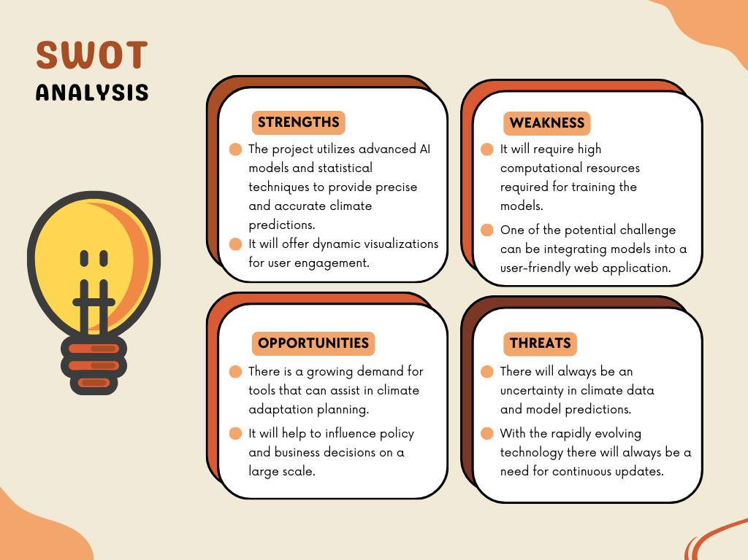
Literature Review

Slide 8
Objective
Main Objective:
The core objective of this project is to develop a predictive model for climate change impacts and integrate it into an interactive web application to assist users in making informed decisions for climate adaptation.
Sub Objective:
Finding the dataset
Implementing the models
Evaluating and performing comparative analysis
Building the web application using the best model

Slide 9
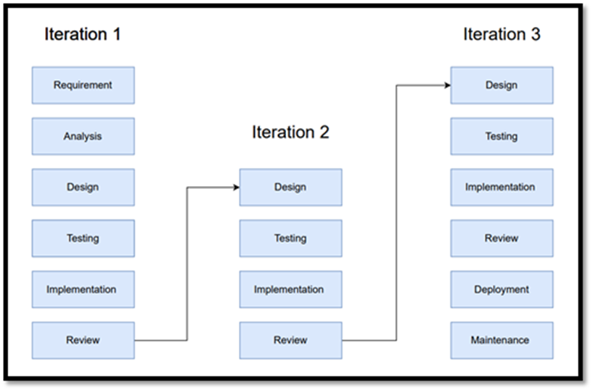
Methodology
Reference Software model
We will be using the Iterative Model to implement our project. The iterative method begins with a basic implementation of a limited set of software requirements in the iterative model, then repeatedly improves the evolving versions until the entire system is built and prepared for deployment.

Slide 10
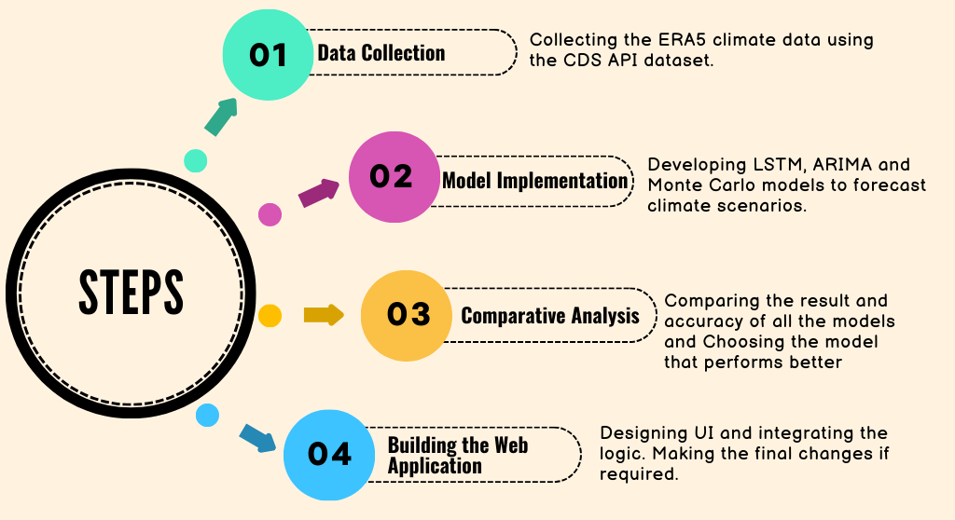
Methodology

Slide 11
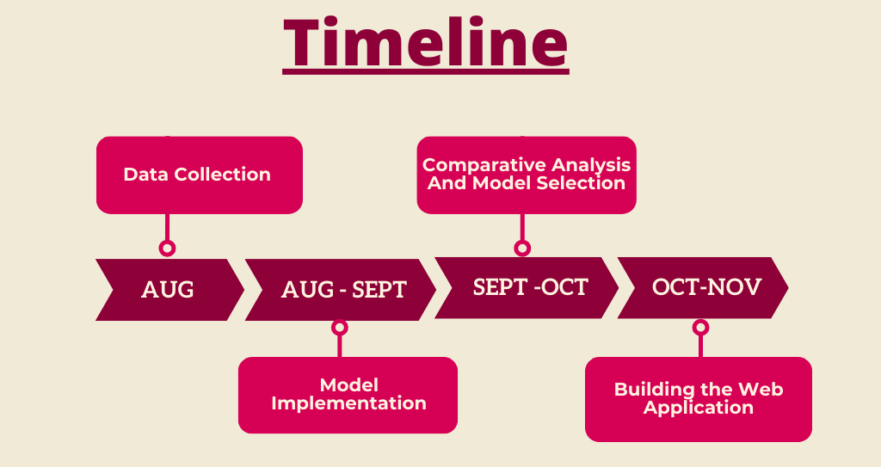
Methodology

Slide 12
Reference
List of cited papers

Slide 13
Thank You

